Slide 1
Predicting Song Popularity1
Annie Titus, Tyler Gigot, Dan Stalica

Slide 2
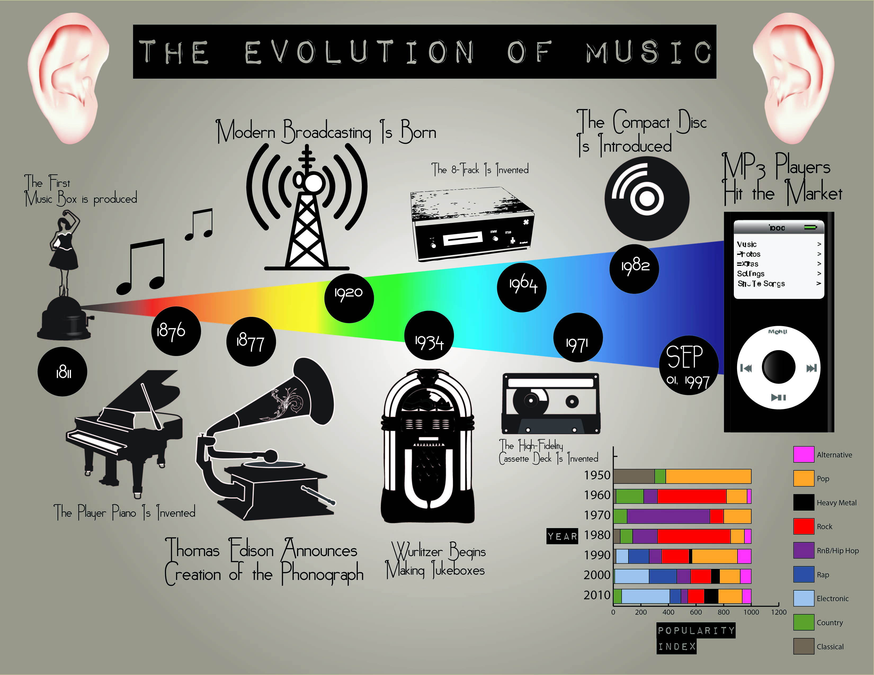
Project Introduction
The evolution of the music industry, driven through technology, has drastically changed the genres and accessibility to music
More recent developments allow for song attributes to be extracted from an audio file
Our Goal:
Allow for artists to be able to accurately predict the popularity of a song through an analysis of the song attributes
https://www.google.com/url?sa=i&url=https%3A%2F%2Fsearch.zonealarm.com%2F%3Fq%3Devolution%2520of%2520music&psig=AOvVaw3-3dYiDhBiTaVjAy6FEDVX&ust=1623783591373000&source=images&cd=vfe&ved=0CA0QjhxqFwoTCIjRhrjnl_ECFQAAAAAdAAAAABAd

Slide 3
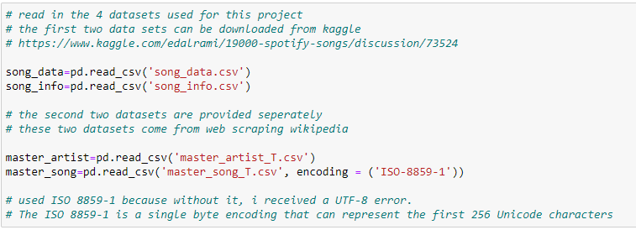
The Data Sets
Sources
Kaggle
song_data.csv
song_info.csv
Web Scraping Performed in R Studio
master_song_T.csv
master_artist_T.csv

Slide 4
Data Definition
Song_data
Song_info
# song_name - the name of the song # song_popularity - the higher the value the more popular the song is # song_duration_ms - the length of the song measured in milliseconds # acousticness - the higher the value the more acoustic the song is # danceability - the higher the value, the easier it is to dance to # energy - the higher the value, the more energtic the song is # instrumentalness - the higher the value, the more instrumental the song is # key - description not provided # liveness - the higher the value, more likely a live recording # loudness - the higher the value, the louder, measured in dB # audio_mode - description not provided # speechiness - the higher the value the more spoken word in the song # tempo - the tempo of the song measured in beats per minute # time_signature - description not provided # audio_valence - the higher the value, the more positive mood
# song_name - the name of the song # artist_name - the name of the corresponding artist(s) # album_names - the name of the corresponding album(s) # playlist - the name of the corresponding playlist(s)
Master_song
Master_artist
# song_id - identifier for the songs # song_name - the name of the song # artist_name - artist of the song # song_single - binary whether the song is a single or not # song_released - the year that the song was released in # song_genre - the corresponding genre(s) for the song # song_label - the corresponding label(s) for the song # song_songwriter - the corresponding songwriter(s) for the song # song_producer - the corresponding producer(s) for the song
# artist_name - the name of the artist # birthday - the date that the artist was born # country - 2 values - either USA or foreign # startyear - the year that the artist started making music

Slide 5
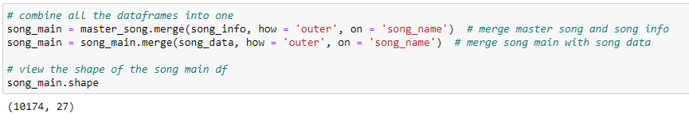
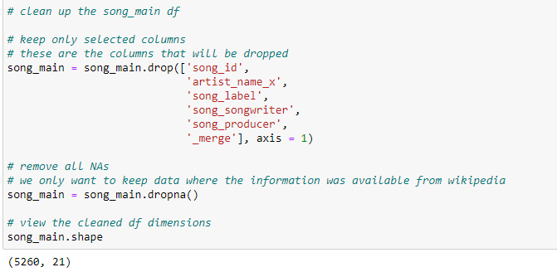
Data Preparation
Merge all 4 data frames into one comprehensive data frame labeled ‘song_main’
Remove all NA and duplicate line items
Final data frame size: 5,260 rows x 21 columns

Slide 6
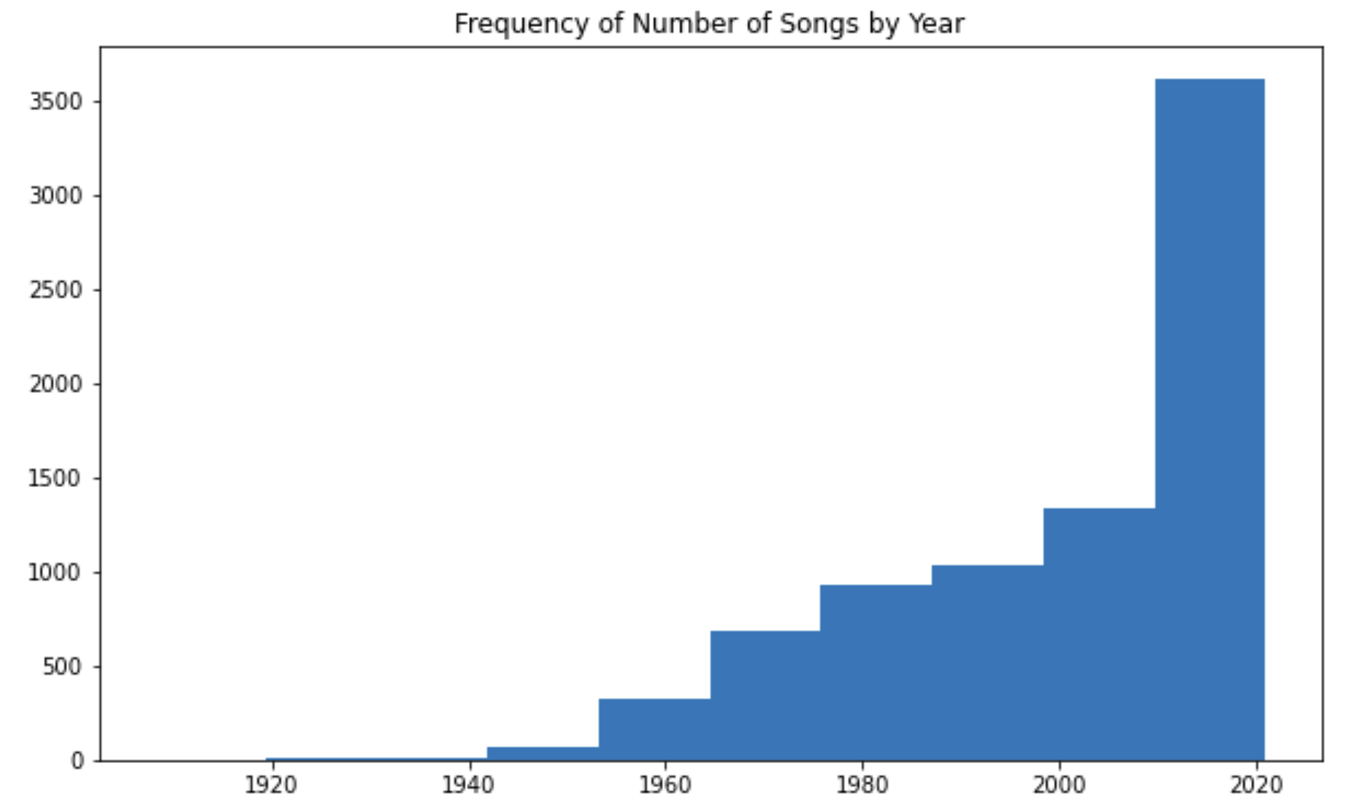
Exploratory Data Analysis & Visualization
Song Distribution
Observations
There are more newer generation songs than older generation songs
There is a particularly larger number of songs between 2010 and 2020
There is a large spike in the number of songs released in 2017-2018
The bias is probably because the creator of the data prefers newer songs

Slide 7
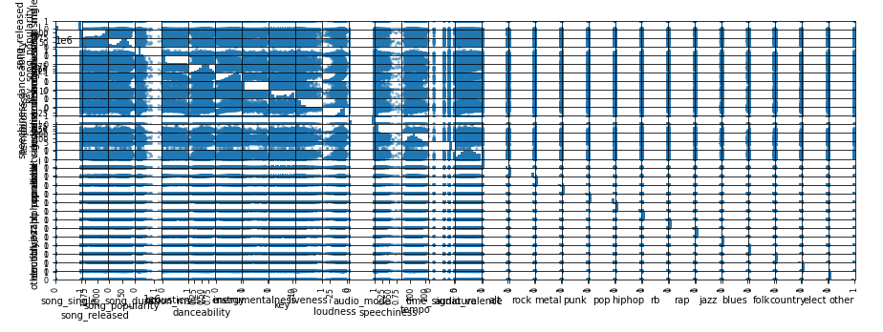
Exploratory Data Analysis & Visualization
Scatter Plot Matrix
Observations
There are too many variables compact together to see any relationship

Slide 8
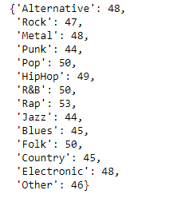
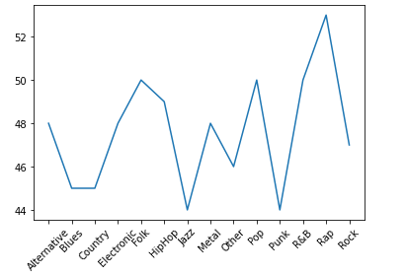
Question 1: What song genre has the most popular songs?
Steps to Answer:
Results: Rap is the most popular
Unpack the song genre
Created a function which searches for a substring
14 genres were found for which multiple songs could fit within
The function iterated through each of the songs and corresponding genres and if it contained the genre, it will provide a 1 for true or a 0 for false

Slide 9
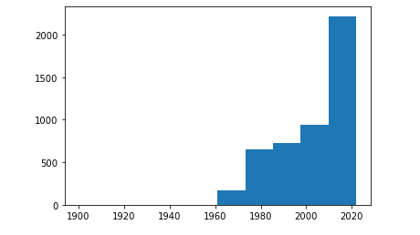
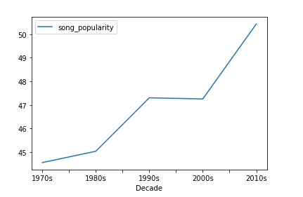
Question 2: How has song popularity changed over time?
Steps to Answer:
Results
First, we plotted a histogram to show the popularity of songs each year between 1969 – 2021
Then, we bin the released year by decades to gain insight on the average popularity by decade
Observations
The average song popularity was steadily increasing between the 1970s -1990s before plateauing between the 1990 and 2000
Since then, it has been on the rise, increasing to 50.54% in the 2010s

Slide 10
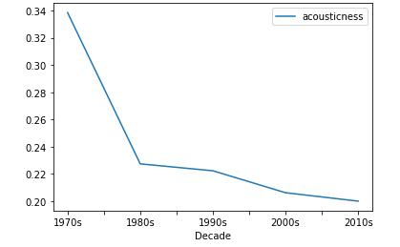
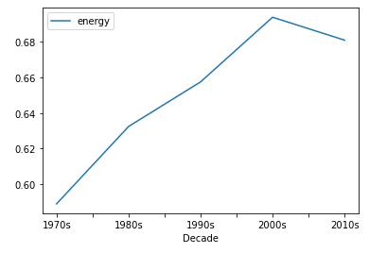
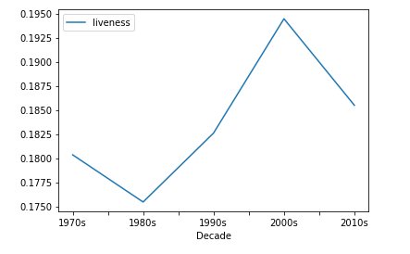
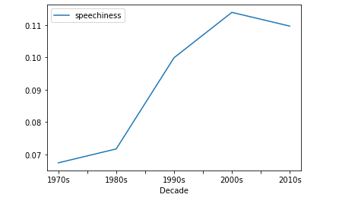
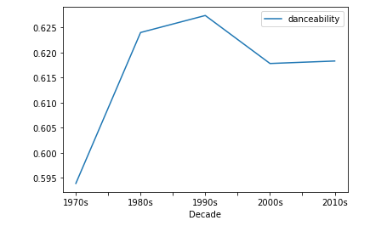
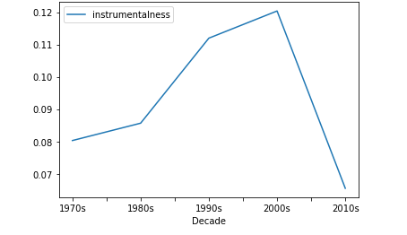
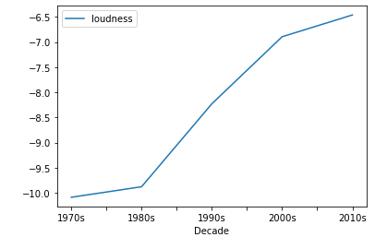
Question 3: How have song attributes changed over years?
Individual Attribute Visuals

Slide 11
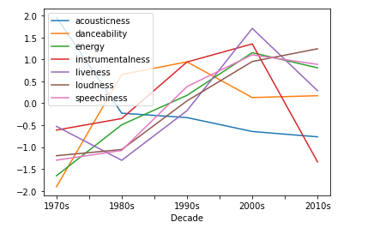
Question 3: How have song attributes changed over years?
Collective Attribute Visual
Observations
Acousticness is the one attribute that has been on the decline throughout the decades
This is likely the result of electronic instruments becoming more prominent
Instrumentalness, Liveness, and Speechiness all increased over time before declining in the 2010s
Energy and Loudness have been heavily increasing over the years.

Slide 12
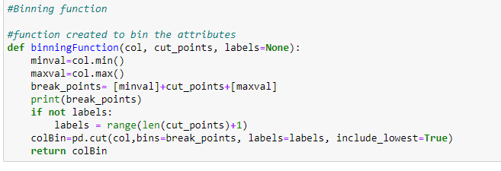
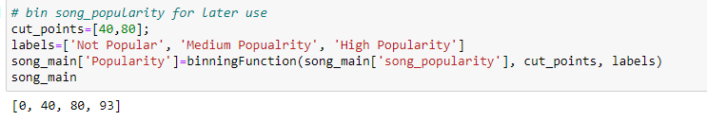
Question 4: Are there certain song attributes that correlate with popularity?
Steps to Answer:
Bin the popular songs from the continuous variable to discrete variables
Not Popular, Medium Popularity, High Popularity
Used the seaborn package based on matplotlib to visually showed the relationship interface between each attribute and song popularity

Slide 13
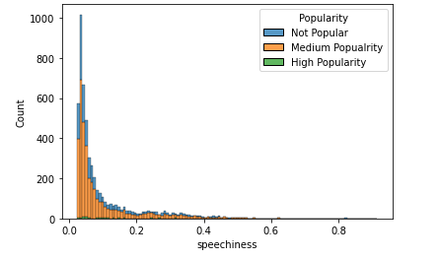
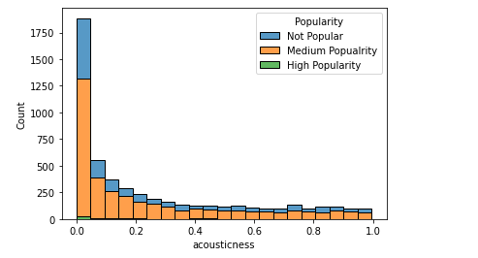
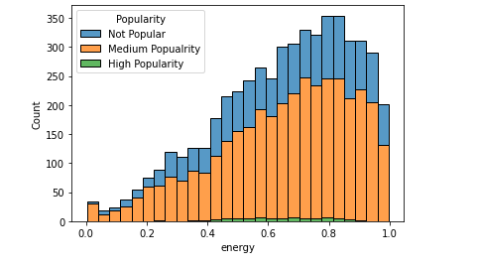
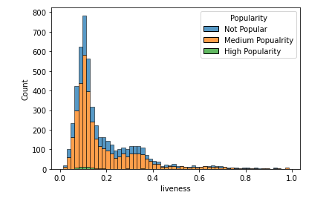
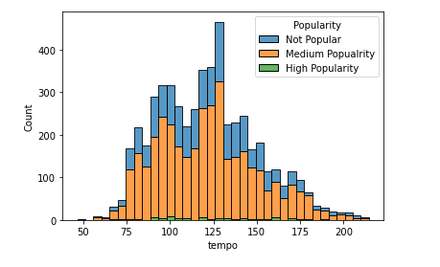
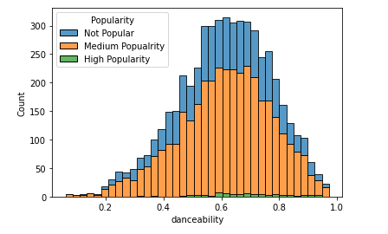
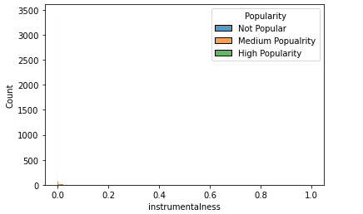
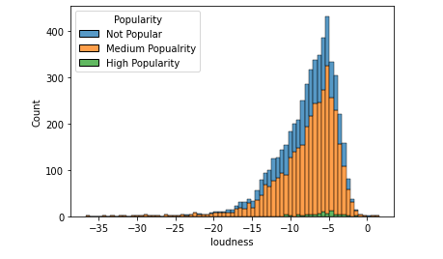
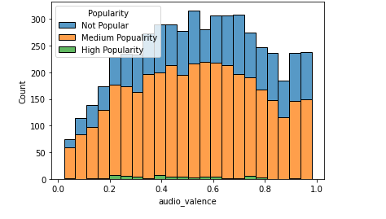
Question 4: Are there certain song attributes that correlate with popularity?
Visualizations

Slide 14
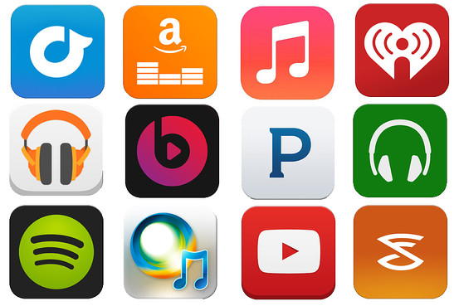
Conclusion
Popular song do have common attributes such as low acousticness, high danceability, high energy, medium tempo
Song popularity has changed drastically over the decades, due to culture and generation interest at the time of the song
Next Steps:
Further collection and cleansing of song data
Analyze cultural events as they relate to the song release date
https://s.wsj.net/public/resources/images/BN-DF456_STREAM_G_20140612162817.jpg

Slide 15
Thank you!2

